Slide 1
Digital Security and Forensics AICT006-4-2-DSF Version 2
Risk Management and Privacy

Slide 2
Topics & Structure of The Lesson
Introduction to Risk
Risk Assessment
Security Surveys and Planning
Security Policies

Slide 3
Learning Outcome
At the end of this topic, You should be able to:
Describe the Risk
Discuss Risk Assessment
Understand Security Surveys and Planning
Understanding Security Policies

Slide 4
Key Terms You Must Be Able To Use
If you have mastered this topic, you should be able to use the following terms correctly in your assignments and exams:
Risk
Risk Assessment

Slide 5
Modules Objectives
Introduction to Risk
Risk Assessment
Security Surveys and Planning
Security Policies

Slide 6
Modules Objectives
Provide an outline of risk, and the terminology used.
Provide an outline to a range of threats
Discuss risks for a facility
Outline disaster recovery plans and procedures

Slide 7
Lecture Content
Introduction to Risk
Risk Assessment
Security Surveys and Planning
Security Policies

Slide 8
Common Terms
Vulnerabilities*: A flaw or weakness in system security procedures, design, implementation, or internal controls that could be exercised.
Threats*: The potential for a source exploit a specific vulnerability, carried out by actor with motivation.
Risk: **The potential that a given threat will exploit vulnerabilities of an asset or group of assets and thereby cause harm to the organization.
* Source: NIST SP 800-30 – Risk Management Guide for Information Technology Systems
** Source: ISO 13335 – Information Technology Security Techniques

Slide 9
Security Management
A broad field of management related to asset (people, buildings, machines, systems and information assets), physical security and human resource safety functions.
Management tools to identify threats, classify the assets and to rate system vulnerabilities so that effective control can be implemented.
E.g. Information classification (Top Secret, Secrete, Confidential and Sensitive), risk assessment (a process to identify potential hazards and analyze what could happen if a hazard occurs.), risk analysis (identifying and quantifying uncertainties, estimating their impact on outcomes that we care about, building a risk analysis).

Slide 10
Risk
Sample list of risks:
Power failure >
Lightning >
Fire >
Password compromise >
Hardware failure >
Static discharge >
Error >
Threat
Business Impact
Vulnerabilities
Risk

Slide 11
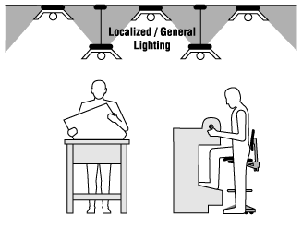
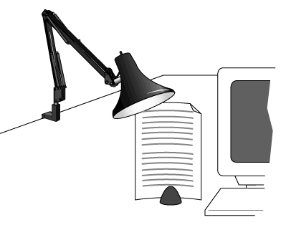
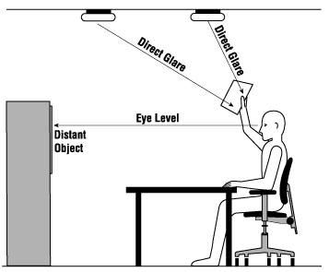
Risk (cont’d)
< A Power Failure is a period of time when the electricity supply to a particular building or area is interrupted, for example because of damage to the cables.
< Eye Discomfort in the Office
Lighting Ergonomics - General

Slide 12


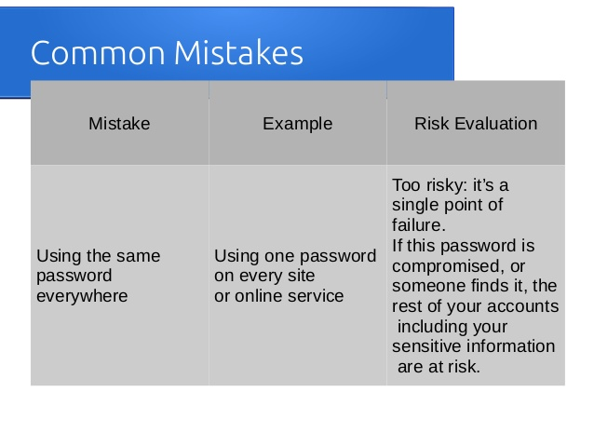
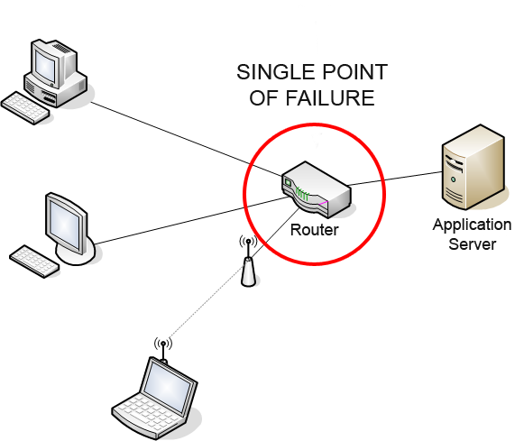
Risk (cont’d)
< chance of loss or injury
Uncertainty or lack of predictability

Slide 13
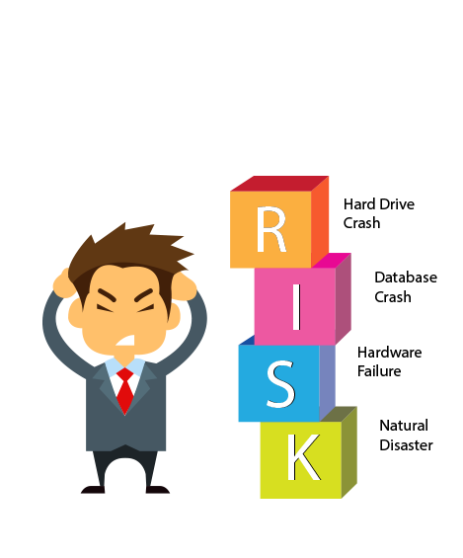
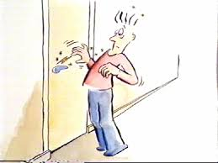
Risk (cont’d)
< Hardware is a common cause of data problems. ... Here are some examples. ... If you don't keep your PC locked in a safe, then this is a risk.
< when you go to touch the doorknob the air between your finger and the knob is charged, this flow from your hand to the doorknob.

Slide 14
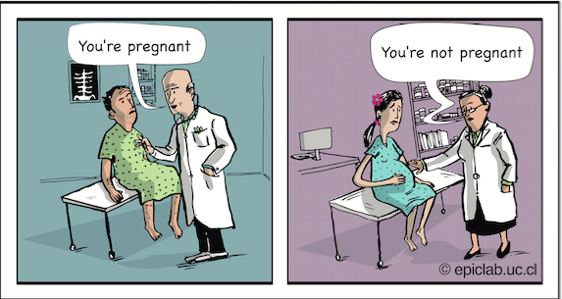

Risk (cont’d)
< False Positive Error
A test result which incorrectly indicates that a particular condition or attribute is present.
False Negative Error
A test result which incorrectly indicates that a particular condition or attribute is absent. You should have got positive result not negative.

Slide 15
Risk (cont’d)
False Positive:
Virus software on your computer incorrectly identifies a harmless program as a malicious one.
A pregnancy test is positive, when in fact you aren’t pregnant.
A cancer screening test comes back positive, but you don’t have the disease.
False Negative:
In the Justice System, a false negative occurs when a guilty suspect is found “Not Guilty” and allowed to walk free.
Quality control in manufacturing; a false negative in this area means that a defective item passes through the cracks.
In software testing, a false negative would mean that a test designed to catch something (i.e. a virus) has failed.

Slide 16
Risk Management
Risk is put into different contexts in terms of definitions, metrics, processes and standards
Mainly from:
Business context
The process of identifying risks, assessing risks and developing strategies to manage risks is known as risk management. A risk management plan and a business impact analysis are important parts of your business continuity plan.
business continuity plan: how it can keep an organization operating during an unplanned event.
business impact analysis: is a process that identifies and evaluates the potential effects of natural and man-made events on.

Slide 17
Risk Management (cont’d)
Technical context
Technical risk deals with feasibility or is a solution that can be delivered within the time and cost constraints of the project?
Technical risk should always be mitigated in the context of working software.
Mitigate risk, demonstrating interfaces, or that one system can talk to another.

Slide 18
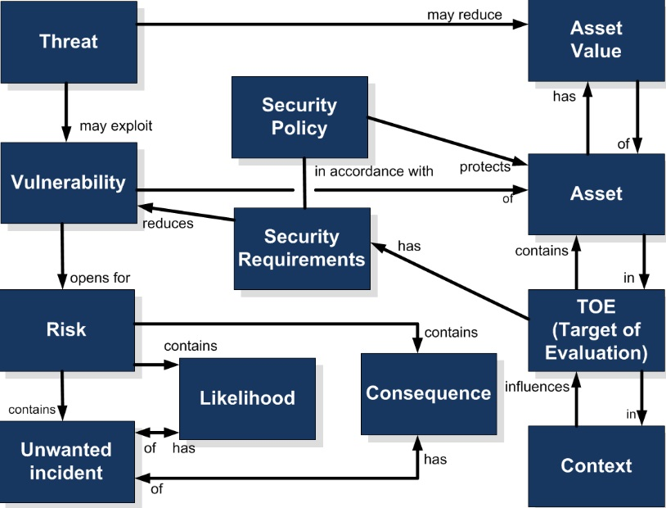
Risk Management Guidelines
Notes:
The TOE is a .... Common Criteria proposes that all security specifications and requirements should come from a general security context that protects assets from threats and categorizes these threats in accordance to their potential .

Slide 19
Risk Management process
1- Identify and uncover risk
2- Determine the likelihood and consequence of each risk
3- Evaluate or rank the risk
4- How can you minimize the probability of the negative risks
5- Monitor, track and review risks
Identify Risk
Analyse Risk
Frequency
Level Risk
Evaluate Risk
Accept/Treat Risk
Consequences
Communicate & Consult
Monitor & Review
Rate the Risk

Slide 20
Risk Management process (cont’d)
Step 1: Identify the Risk. uncover, recognize and describe risks that might affect your project or its outcomes. There are a number of techniques you can use to find project risks. During this step you start to prepare your Project Risk Register.
Step 2: Analyze the risk. Once risks are identified you determine the likelihood and consequence of each risk. You develop an understanding of the nature of the risk and its potential to affect project goals and objectives. This information is also input to your Project Risk Register.
Step 3: Evaluate or Rank the Risk. You evaluate or rank the risk by determining the risk magnitude, which is the combination of likelihood and consequence. You make decisions about whether the risk is acceptable or whether it is serious enough to warrant treatment. These risk rankings are also added to your Project Risk Register.

Slide 21
Risk Management process (cont’d)
Step 4: Treat the Risk. This is also referred to as Risk Response Planning. During this step you assess your highest ranked risks and set out a plan to treat or modify these risks to achieve acceptable risk levels. How can you minimize the probability of the negative risks as well as enhancing the opportunities? You create risk mitigation strategies, preventive plans and contingency plans in this step. And you add the risk treatment measures for the highest ranking or most serious risks to your Project Risk Register.
Business contingency plan : is used for risk management when an exceptional risk that, though unlikely, would have catastrophic consequences (burdensome/heavy). Contingency plans are often divided by governments or businesses.
Step 5: Monitor and Review the risk. This is the step where you take your Project Risk Register and use it to monitor, track and review risks.

Slide 22
Other Components
Vulnerabilities
Weakness of the current system/process
E.g. Enforcement of scanning ID cards for accessing building/room
E.g. Smoke detector installation in the building
Threats
Acts that damage/harm the business/organization
E.g. Hackers, intruders stealing information
E.g. Virus attacks that destroy files
More discussions on next chapter

Slide 23
Example of Risk Assessment
Fabric Manufacturer
Risks
Fire (High Risk)
Machinery failure (Medium Risk)
Chemical leakage (Low Risk)
Analysis
Questionnaires distributed to Managers, operational staff, coordinator, chemist
Observations
Control and Policies
Fire extinguisher
Back up machine/operates old machine
Providing/ demonstration face mask

Slide 24
Samples
Business Impact Analysis sample
Disaster Recovery Plan 1 sample
Disaster Recovery Plan 2 sample
Risk Assessment 1 sample
Risk Assessment 2 sample

Slide 25
Outcomes
Cloud services for back up
Virtualizations – temporarily sessions for
Proxy Servers for network control
Service Oriented Architecture (SOA) – ticketing servers to identify users and provision services

Slide 26
Quick Review Question
Form a team to discuss the operations and analyze risk of the following industries:
Power generation plant
Petroleum refinery
Water treatment center
Blood bank
Food ingredient supplier
Air flight control tower
Notes:
Students are to link topics in chapter 3 & 4 to provide valid answers. These type of questions are the usual questions that are asked in test/exams.

Slide 27
Summary
Risk – potential problem due to weakness found in the system
Risk Assessment – analysis process to avoid/prevent risk from happening
Security Policies – procedures/rules set by an organization in maintaining smooth flow of a business

Slide 28
Q & A

